Slide 1
UNIT-III
Medium Access Control

Slide 2
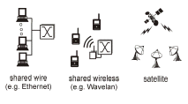
Multiple Access
Broadcast link used in LAN consists of multiple sending and receiving nodes connected to or use a single shared link

Slide 3
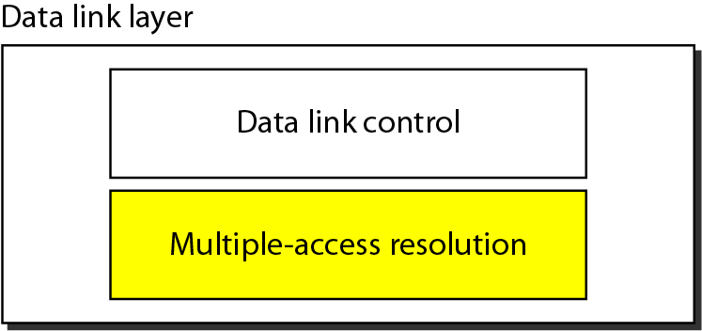
Data link layer divided into two functionality-
oriented sublayers:
Responsible for error and flow control
Link Layer Control (LLC)
Control
MAC
Responsible framing and MAC address and Multiple Access Control

Slide 4
Multiple Access
Problem: When two or more nodes transmit at the same time, their frames will collide and the link bandwidth is wasted during collision
How to coordinate the access of multiple sending/receiving nodes to the shared link???
Solution: We need a protocol to coordinate the transmission of the active nodes

Slide 5
These protocols are called Medium or Multiple Access Control (MAC) Protocols belong to a sublayer of the data link layer called MAC (Medium Access Control)
What is expected from Multiple Access Protocols:
Main task is to minimize collisions in order to utilize the bandwidth by:
Determining when a station can use the link (medium)
what a station should do when the link is busy
what the station should do when it is involved in collision

Slide 6
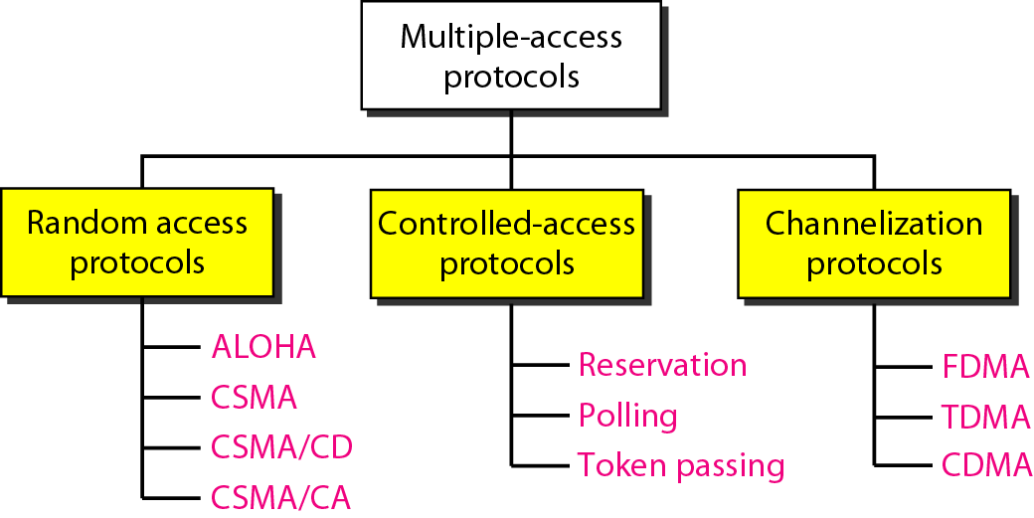
Taxonomy of multiple-access protocols

Slide 7
Channel Allocation Basic problem: How to allocate a multi-access channel among competing users.
In other words, we need a set of rules (i.e. a protocol) to allow each user to communicate and avoid interference. There are a variety of solutions to this problem that are used in practice.
These solutions can be classified as either static or dynamic.

Slide 8
With a static approach, the channel's capacity is essentially divided into fixed portions; each user is then allocated a portion for all time.
If the user has no traffic to use in its portion, then it goes unused.

Slide 9
With a dynamic approach the allocation of the channel changes based on the traffic generated by the users.
Generally, a static allocation performs better when the traffic is predictable.
A dynamic channel allocation tries to get better utilization and lower delay on a channel when the traffic is unpredictable.

Slide 10
Random Access
Also called contention-based access method.
No station is assigned to control another.
No station is superior to another station.
No station permits, or does not permit,
another station to send.

Slide 11
Two features give this method its name.
First, there is no scheduled time for a station
to transmit. Transmission is random among the stations. That is why these methods are
called random access.
Second, no rules specify which station should send next. Stations compete with one another to access the medium. That is why these methods are also called contention methods.

Slide 12
ALOHA
ALOHA, the earliest random access method, was developed by Norman Manuel Abramson at the University of Hawaii in early 1970. It was designed for a radio (wireless) LAN, but it can be used on any shared medium.
It is obvious that there are potential collisions in this arrangement. The medium is shared between the stations. When a station sends data, another station may attempt to do so at the same time. The data from the two stations collide and become garbled.

Slide 13
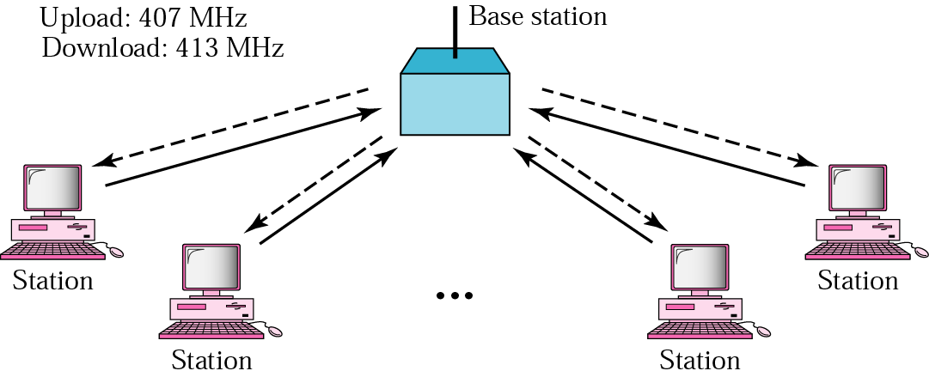
ALOHA Network

Slide 14
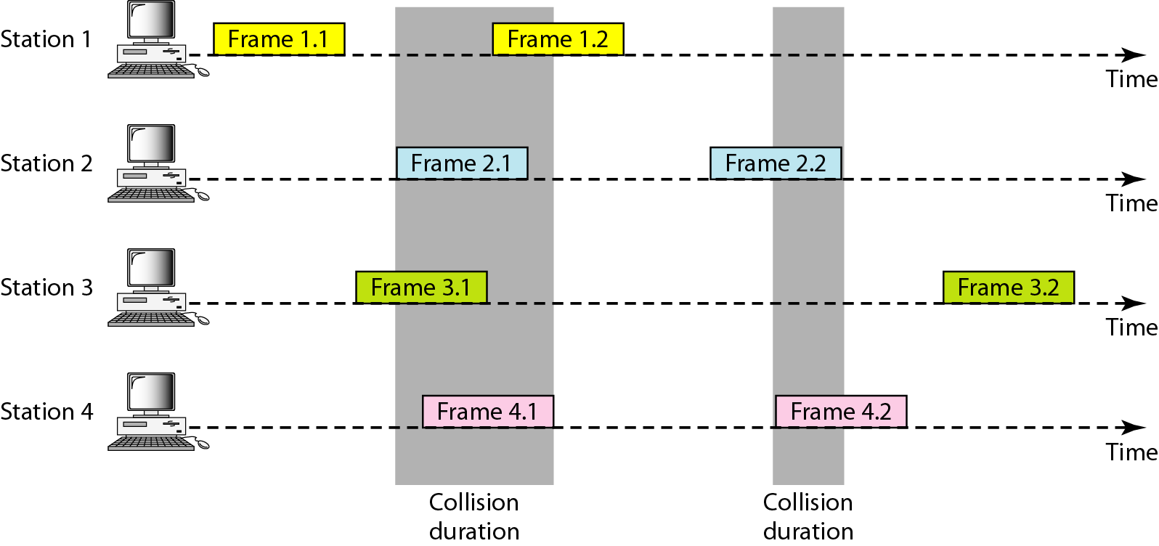
Frames in a pure ALOHA network

Slide 15
Pure ALOHA Protocol Description: -
All frames from any station are of fixed length (L bits)
Stations transmit at equal transmission time (all
stations produce frames with equal frame lengths).
A station that has data can transmit at any time.
After transmitting a frame, the sender waits for an
acknowledgment for an amount of time (time out).
If no ACK was received, sender assumes that the
frame or ACK has been destroyed and resends that
frame after it waits for a random amount of time.

Slide 16
If station fails to receive an ACK after repeated
transmissions, it gives up.
Channel utilization or efficiency or Throughput
is the percentage of the transmitted frames that
arrive successfully (without collisions) or the
percentage of the channel bandwidth that will be
used for transmitting frames without collisions.
ALOHA Maximum channel utilization is 18% (i.e, if the system produces F frames/s, then 0.18 * F frames will arrive successfully on average without the need of retransmission).

Slide 17
A collision involves two or more stations. If all these stations try to resend their frames after the time-out, the frames will collide again.
Pure ALOHA dictates that when the time-out period passes, each station waits a random amount of time before resending its frame. The randomness will help avoid more collisions. We call this time the back-off time TB.

Slide 18
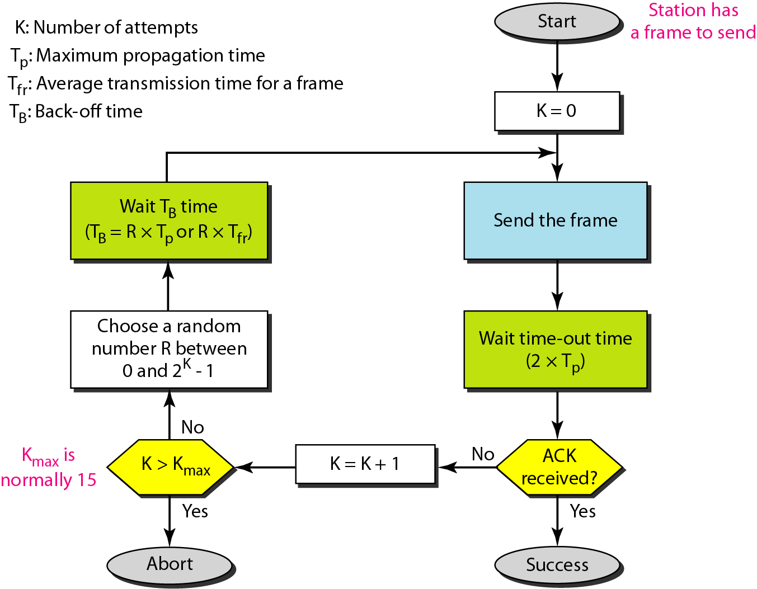
Procedure for pure ALOHA Protocol

Slide 19
Example
Calculate possible values of T_{B} when stations on an ALOHA network are a maximum of 600 km apart
T_{p} = Distance/Propagation Speed
T_{p=} (600 × 10³) / (3 × 10⁸) = 2 ms
When K=1, T_{B} ∈ {0ms,2ms}
When K=2, T_{B} ∈ {0ms,2ms,4ms,6ms}

Slide 20
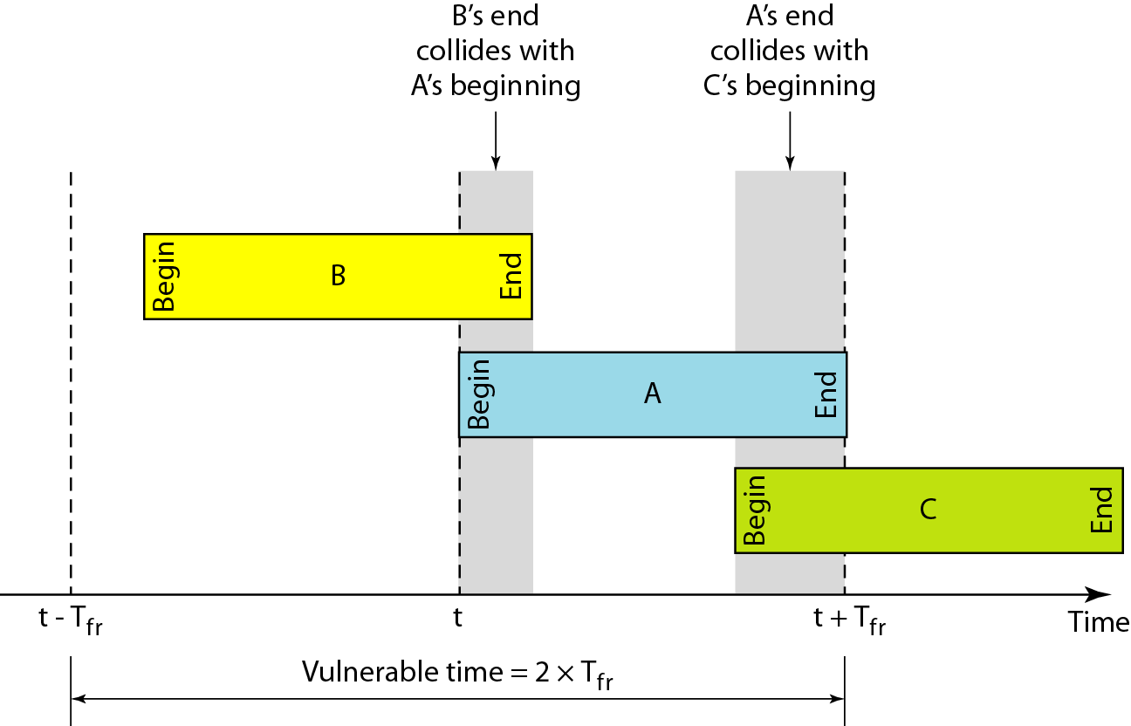
Vulnerable time for pure ALOHA protocol

Slide 21
If the frame transmission time is T sec, then the vulnerable time is = 2 T sec.
This means no station should send during the T-sec before this station starts transmission and no station should start sending during the T-sec period that the current station is sending.

Slide 22
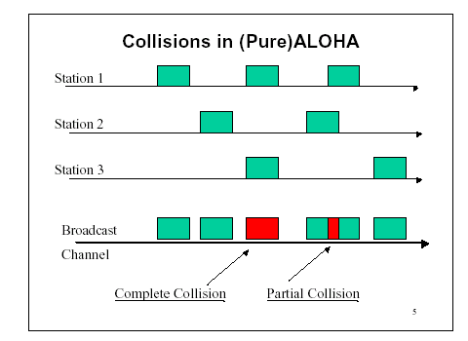
Pure ALOHA
In pure ALOHA, frames are transmitted at completely arbitrary times.

Slide 23
Random Access – Slotted ALOHA
Pure ALOHA has a vulnerable time of 2 x Tfr .
This is so because there is no rule that defines
when the station can send.
A station may send soon after another station
has started or soon before another station has
finished.
Slotted ALOHA was invented to improve the
efficiency of pure ALOHA.

Slide 24
Time is divided into slots equal to a frame transmission time (T_{fr})
A station can transmit at the beginning of a slot only
If a station misses the beginning of a slot, it has to wait until the beginning of the next time slot.
A central clock or station informs all stations about the start of a each slot
Maximum channel utilization is 37%

Slide 25
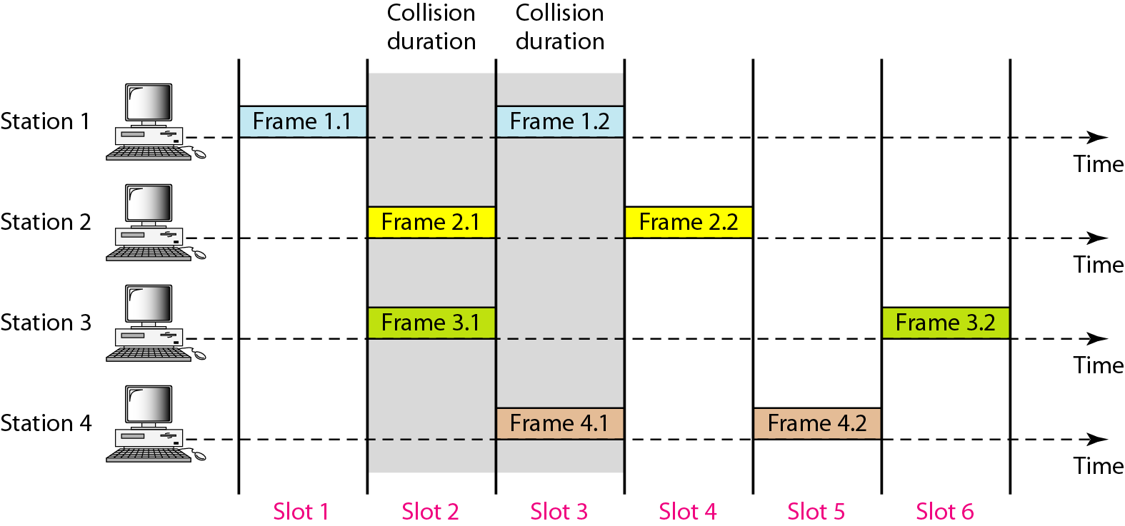
Frames in a slotted ALOHA network

Slide 26
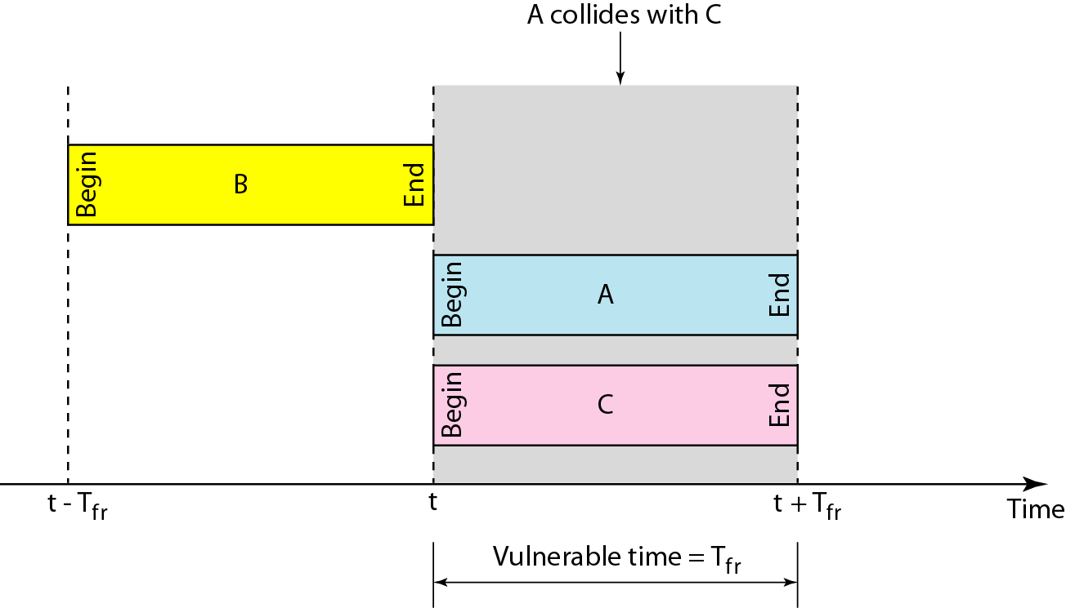
In danger time for slotted ALOHA protocol

Slide 27
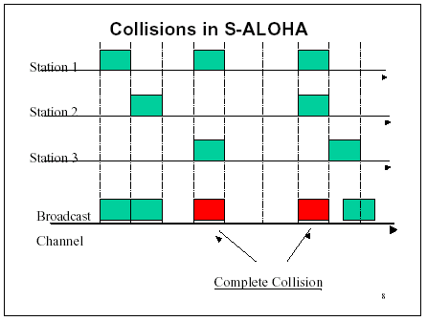
Random Access – Slotted ALOHA

Slide 28
Advantage of ALOHA protocols
A node that has frames to be transmitted can transmit continuously at the full rate of channel if it is the only node with frames
Simple to be implemented.
No master station is needed to control the medium.

Slide 29
Disadvantage: -
If (M) nodes want to transmit, many collisions can occur and the rate allocated for each node will not be on average R/M bps
This causes low channel utilization.

Slide 30
CSMA
To minimize the chance of collision and, therefore, increase the performance, the CSMA method was developed.
The chance of collision can be reduced if a station senses the medium before trying to use it.
Carrier sense multiple access (CSMA) requires that each station first listen to the medium (or check the state of the medium) before sending. In other words, CSMA is based on the principle "sense before transmit" or "listen before talk”

Slide 31
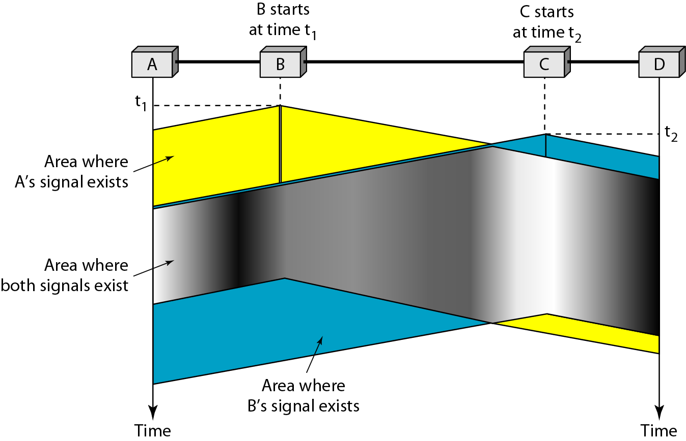
Space/time model of the collision in CSMA

Slide 32
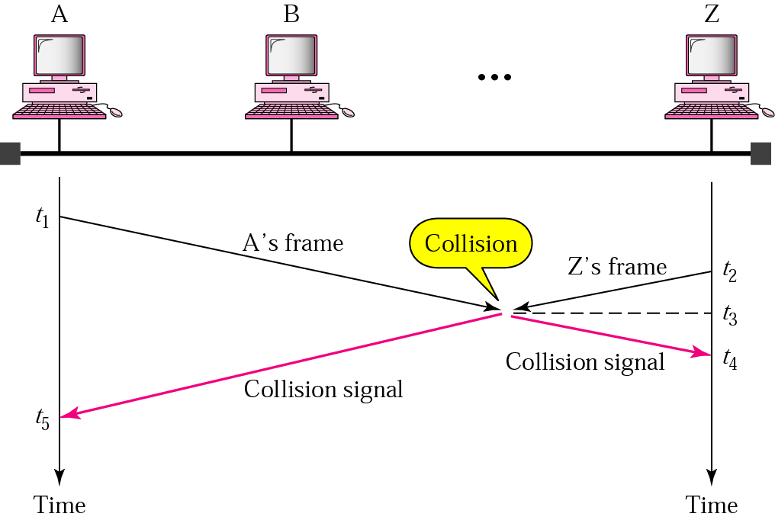
Random Access – Carrier Sense Multiple Access (CSMA)

Slide 33
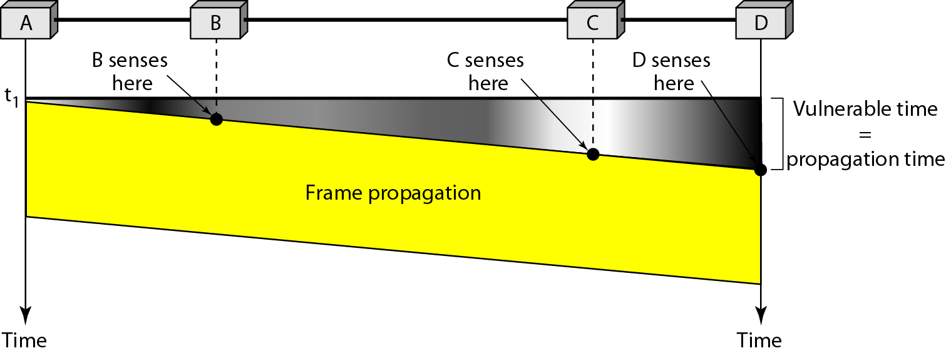
Random Access – Carrier Sense Multiple Access (CSMA)
Vulnerable time for CSMA is the maximum propagation time

Slide 34
Vulnerable Time : This is the time needed for a signal to propagate from one end of the medium to the other.
When a station sends a frame, and any other station tries to send a frame during this time, a collision will result.
But if the first bit of the frame reaches the end of the medium, every station will already have heard the bit and will refrain from sending.

Slide 35
Types of CSMA Protocols
Different CSMA protocols that determine:
What a station should do when the medium is idle?
What a station should do when the medium is busy?
Non-Persistent CSMA
1-Persistent CSMA
p-Persistent CSMA
Notes:
Persistent – Continue to do something.

Slide 36
Nonpersistent CSMA
A station with frames to be sent, should sense the medium
If medium is idle, transmit; otherwise, go to 2
If medium is busy, (backoff) wait a random amount of time and repeat 1
Non-persistent Stations are deferential (respect others).

Slide 38
Performance:
Random delays reduces probability of collisions because two stations with data to be transmitted will wait for different amount of times.
Bandwidth is wasted if waiting time (backoff) is large because medium will remain idle following end of transmission even if one or more stations have frames to send

Slide 39
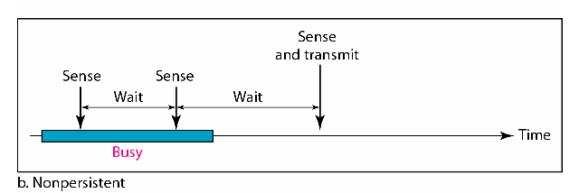
Random Waiting times
Wasted time

Slide 40
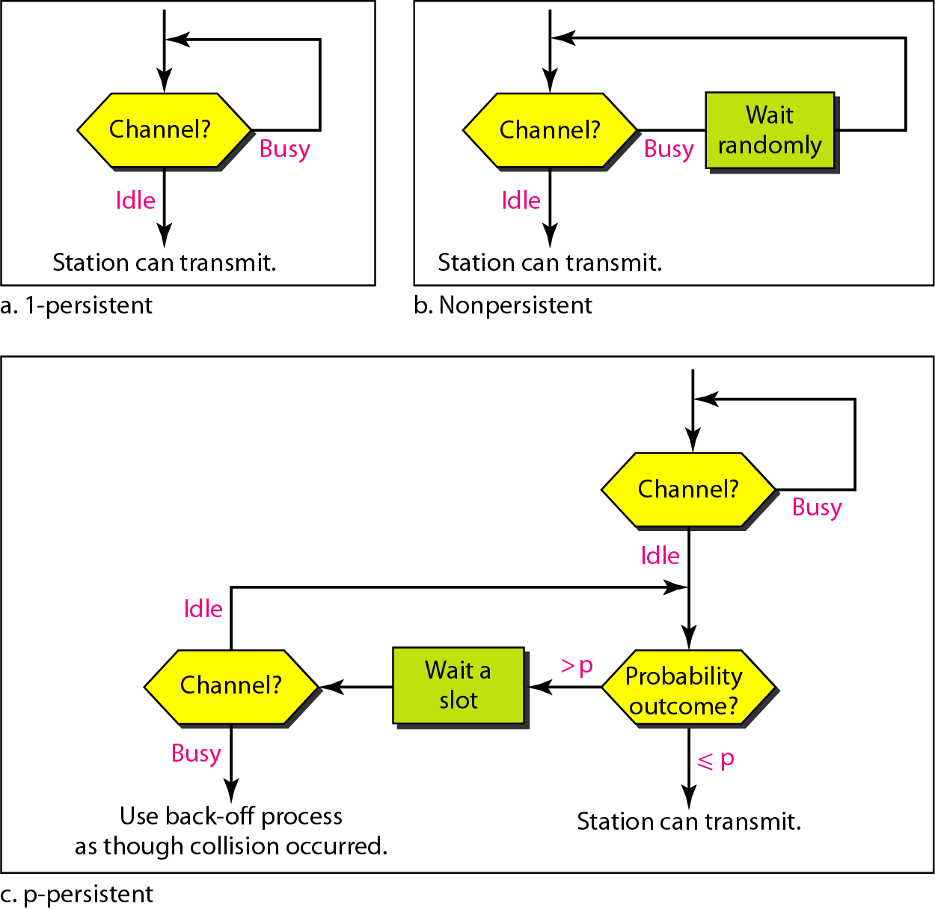
Flow diagram for three persistence methods

Slide 41
1-persistent CSMA
To avoid idle channel time, 1-persistent protocol used
Station wishing to transmit listens to the medium:
If medium idle, transmit immediately;
If medium busy, continuously listen until medium becomes idle; then transmit immediately with probability 1
Performance
1-persistent stations are selfish.
If two or more stations becomes ready at the same time, collision guaranteed.

Slide 42
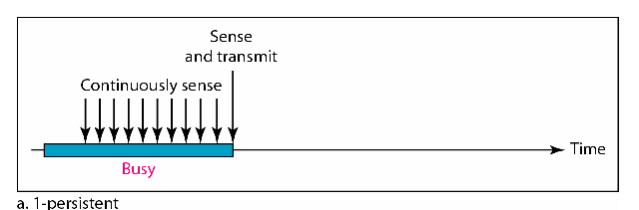

Slide 43
Flow diagram for three persistence methods

Slide 44
P-persistent CSMA
Time is divided to slots where each Time unit (slot) typically equals maximum propagation delay.
Station wishing to transmit listens to the medium:
If medium idle,
transmit with probability (p), OR
wait one time unit (slot) with probability (1 – p), then repeat 1.

Slide 45
2. If medium busy, continuously listen until idle and repeat step 1
Performance
Reduces the possibility of collisions like nonpersistent
Reduces channel idle time like 1-persistent

Slide 46
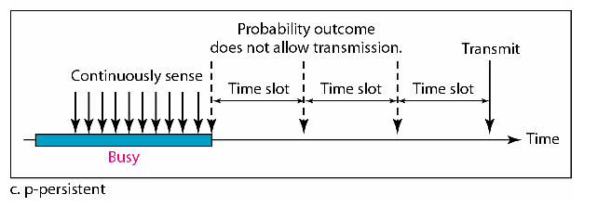

Slide 47
Flow diagram for three persistence methods

Slide 48
CSMA/CD
CSMA (all previous methods) has an inefficiency:
If a collision has occurred, the channel is unstable until colliding packets have been fully transmitted.
CSMA/CD (Carrier Sense Multiple Access with Collision Detection) overcomes this as follows:

Slide 49
While transmitting, the sender is listening to medium for collisions.
Sender stops transmission if collision has occurred reducing channel wastage .
CSMA/CD is Widely used for bus topology LANs (IEEE 802.3, Ethernet).

Slide 50
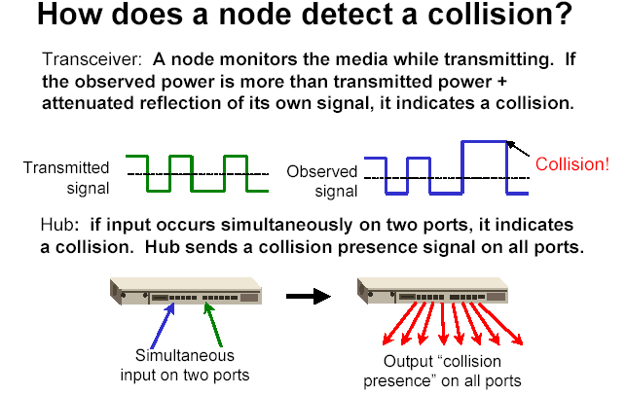
of its own
signal, it means collision occurred

Slide 51
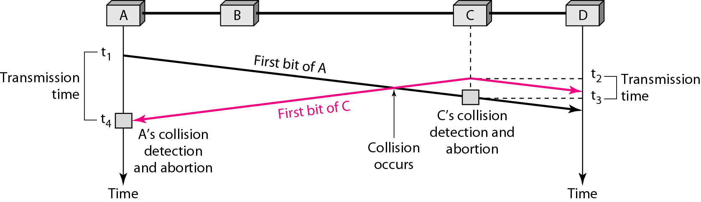
Collision of the first bit in CSMA/CD

Slide 52
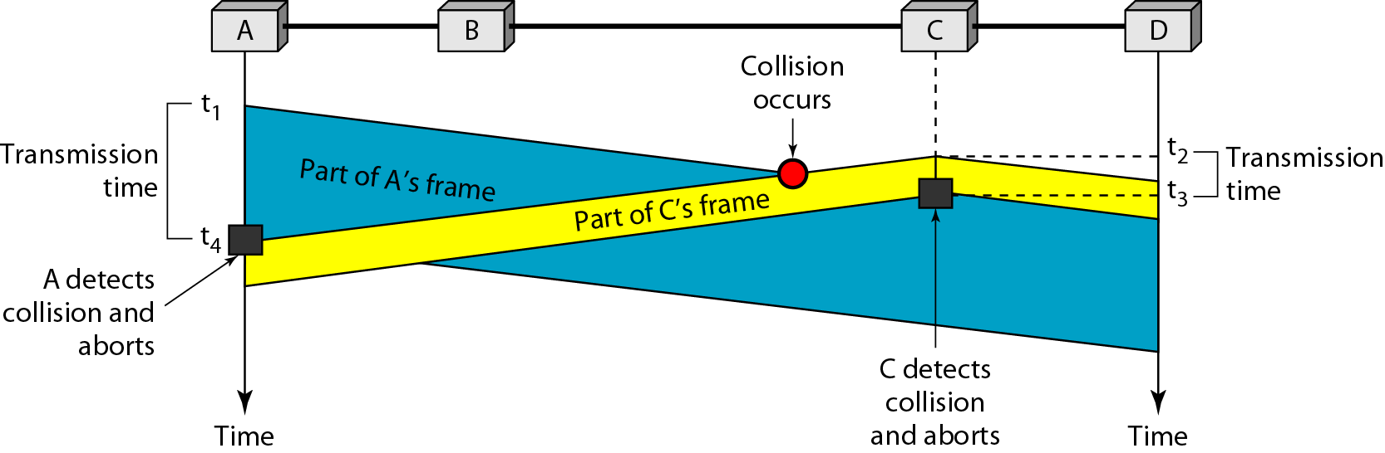
Collision and abortion in CSMA/CD
Station monitors channel while sending a frame

Slide 53
CSMA/CD: Minimum Frame Size
Each frame must be large enough for a sender to detect a collision.
Worst case scenario:
"A" is transmitting
"D" starts transmitting just before A's signal arrives
A
B
C
D
Long enough to hear colliding signal from D

Slide 54
we need a restriction on the frame size. Before sending the last bit of the frame, the sending station must detect a collision, if any, and abort the transmission.
This is so because the station, once the entire frame is sent, does not keep a copy of
the frame and does not monitor the line for collision detection.

Slide 55
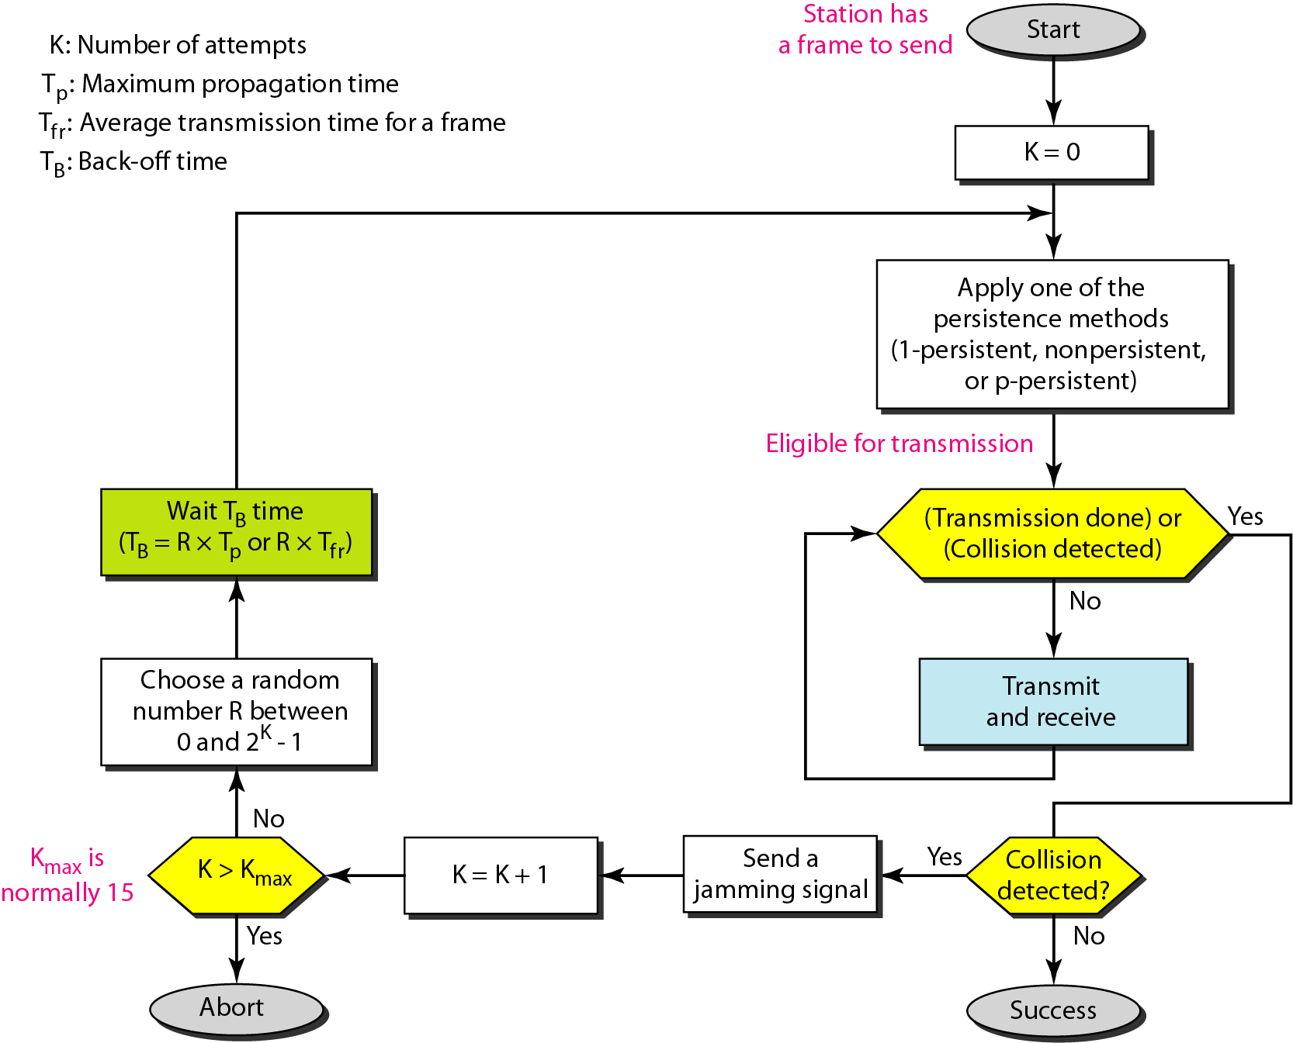
Flow diagram for the CSMA/CD

Slide 56
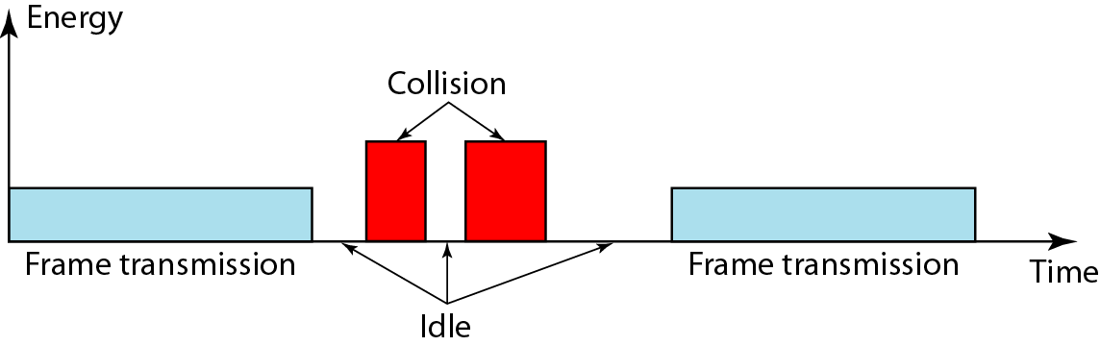
Energy level during transmission, idleness,
or collision

Slide 57
The level of energy in a channel can have
three values: zero, normal, and abnormal.
Station that has a frame to send or is sending
a frame needs to monitor the energy level to
determine if the channel is idle, busy, or in
collision mode.

Slide 58
CSMA/CA
When there is no collision, the station receives one signal: its own signal.
When there is a collision, the station receives two signals: its own signal and the signal transmitted by a second station.
To distinguish between these two cases, the received signals in these two cases must be significantly different.

Slide 59
In other words, the signal from the second station needs to add a significant amount of energy to the one created by the first station.
In a wireless network, much of the sent energy is lost in transmission. The received signal has very little energy. Therefore, a collision may add only 5 to 10 percent additional energy. This is not useful for effective collision detection.

Slide 60
We need to avoid collisions on wireless networks because they cannot be detected.
Carrier sense multiple access with collision avoidance (CSMA/CA) was invented for this
network.
Collisions are avoided through the use of CSMA/CA's three strategies:
The interframe space,
The contention window, and
Acknowledgments

Slide 61
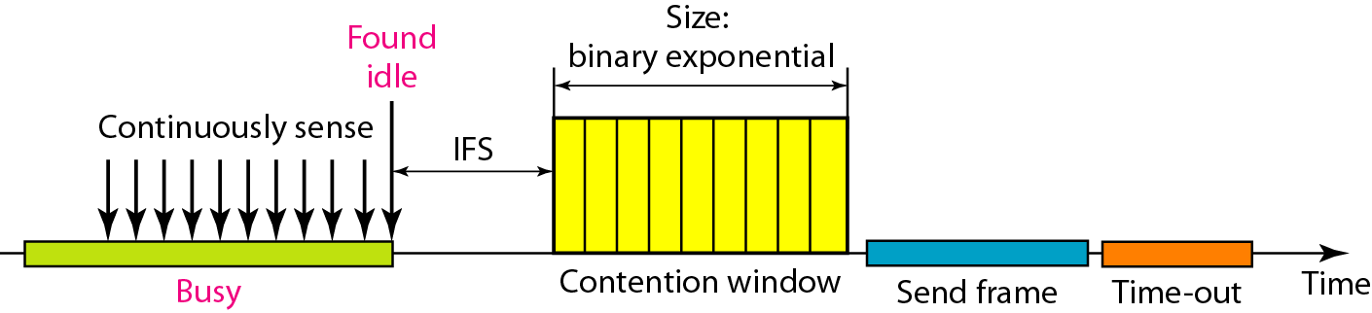
Timing in CSMA/CA

Slide 62
Interframe Space (IFS):
First, collisions are avoided by deferring transmission even if the channel is found idle.
When an idle channel is found, the station does not send immediately. It waits for a period of time called the interframe space or IFS.

Slide 63
Contention window:
In CSMA/CA, if the station finds the channel busy, it does not restart the timer of the contention window; it stops the timer and restarts it when the channel becomes idle.
Acknowledgment :
With all these precautions, there still may be a collision resulting in destroyed data. In addition, the data may be corrupted during the transmission. The positive acknowledgment and the time-out timer can help guarantee that the receiver has received the
Frame.

Slide 64
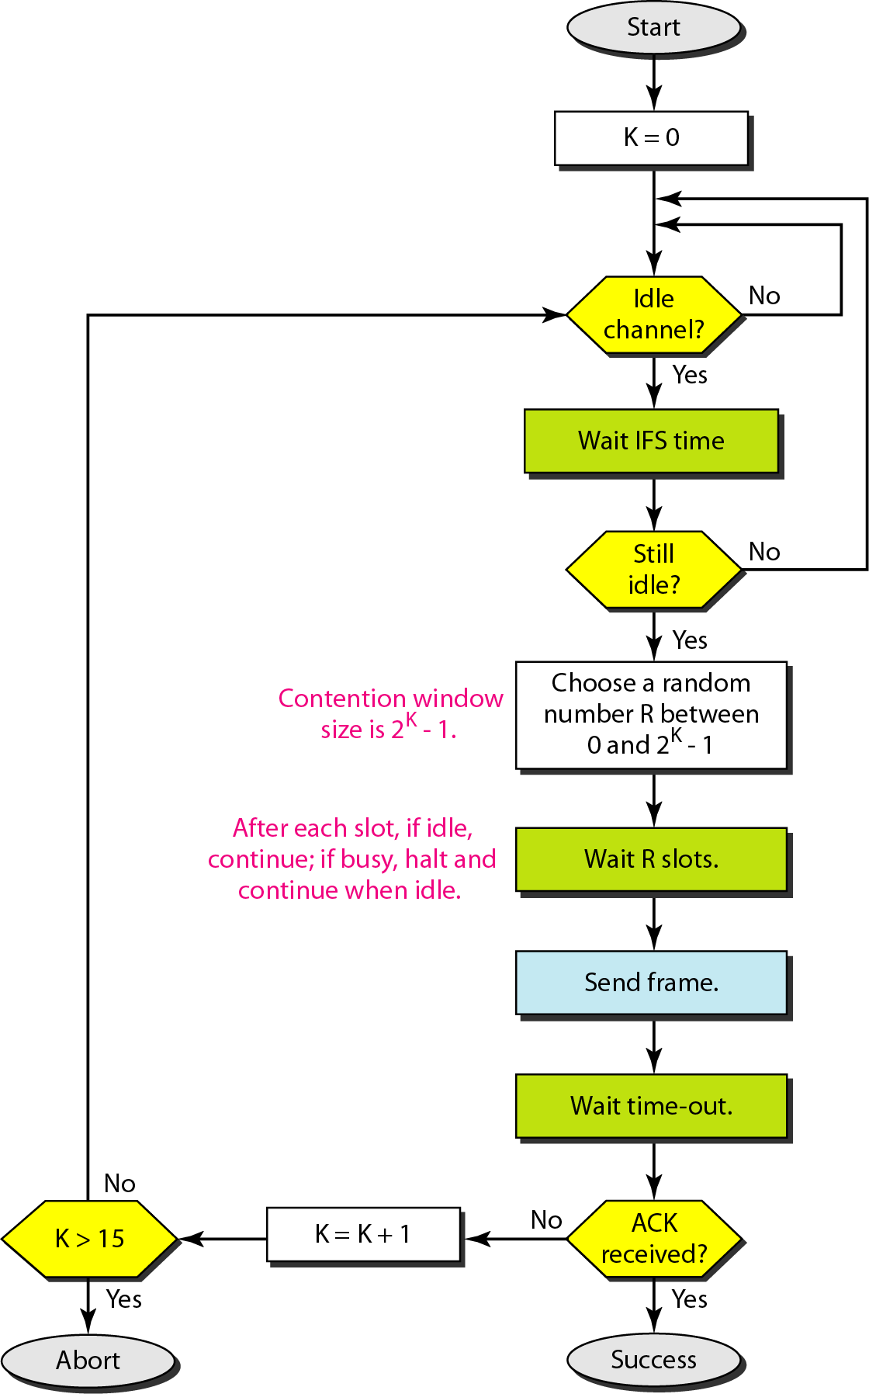
Flow diagram for CSMA/CA

Slide 65
STANDARD ETHERNET
The original Ethernet was created in 1976 at Xerox’s Palo Alto Research Center (PARC). Since then, it has gone through four generations.

Slide 66
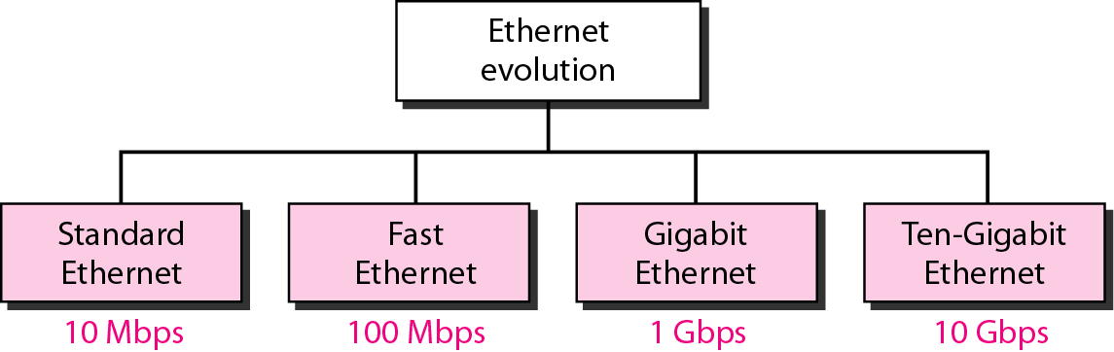
Ethernet evolution through four generations

Slide 67
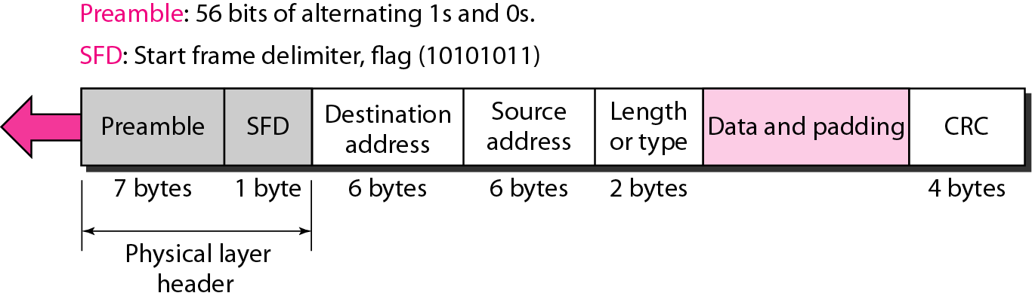
802.3 MAC frame

Slide 68
Preamble: - That alerts the receiving system to the coming frame and enables it to synchronize its input timing.
The pattern provides only an alert and a timing pulse.
The preamble is actually added at the physical layer and is not (formally) part of the frame.
Start frame delimiter (SFD). The second field (l byte: 10101011) signals the beginning of the frame. The SFD warns the station or stations that this is the last chance for synchronization. The last 2 bits is 11 and alerts the receiver that the next field is the destination address.

Slide 69
Length or type. The original Ethernet used this field as the type field to define the upper-layer protocol using the MAC frame.
The IEEE standard used it as the length field to define the number of bytes in the data field.

Slide 70
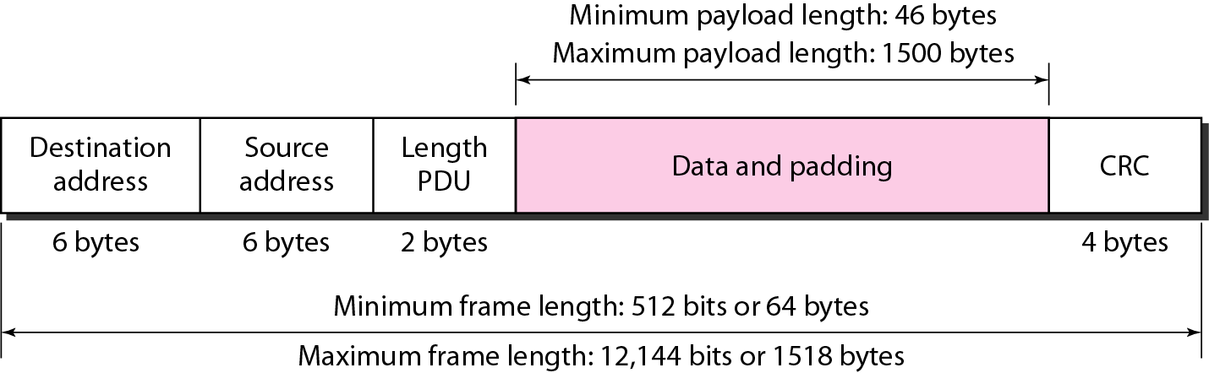
Minimum and maximum lengths

Slide 71
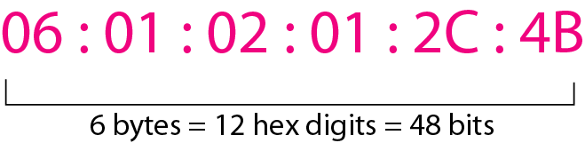
Example of an Ethernet address
in hexadecimal notation

Slide 72
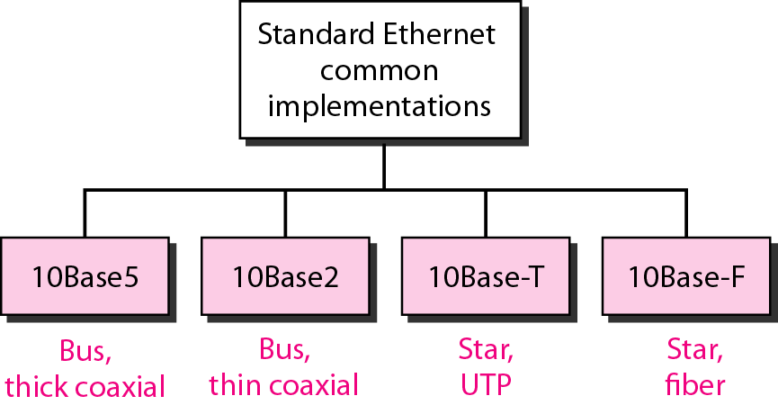
Physical Layer: Categories of Standard Ethernet

Slide 73
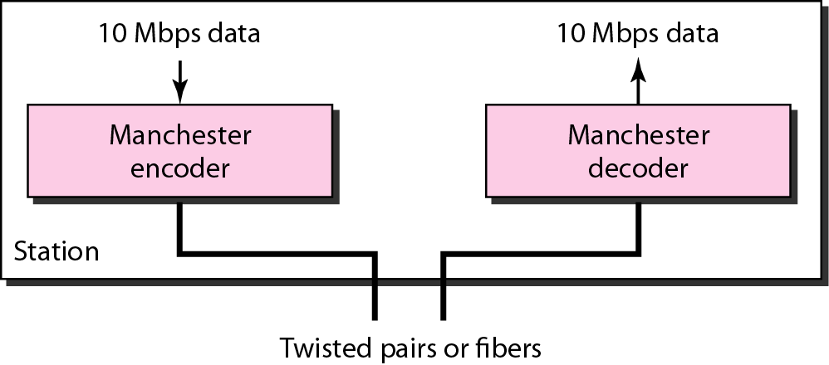
Encoding in a Standard Ethernet implementation
All standard implementations use digital signaling at 10 Mbps

Slide 74
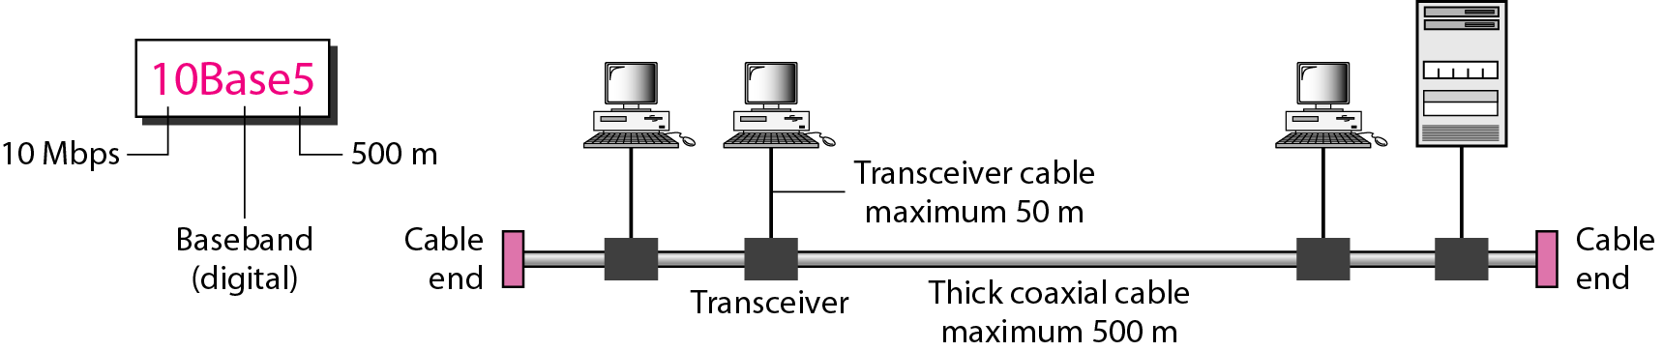
10Base5 implementation
10Base5 ,thick Ethernet or thicknet

Slide 75
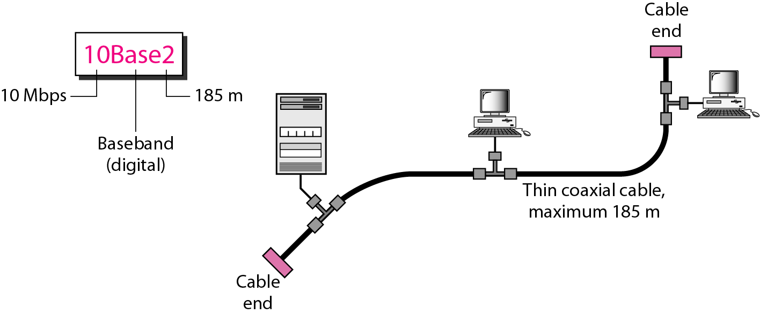
10Base2 implementation

Slide 76
Cheapernet.
The cable is much thinner and more flexible.
The transceiver is normally part of the
network interface card (NIC).
The collision here occurs in the thin coaxial
cable.
More cost effective than 10Base5.
The length of each segment cannot exceed
185 m (close to 200 m) due to the high level
of attenuation in thin coaxial cable.

Slide 77
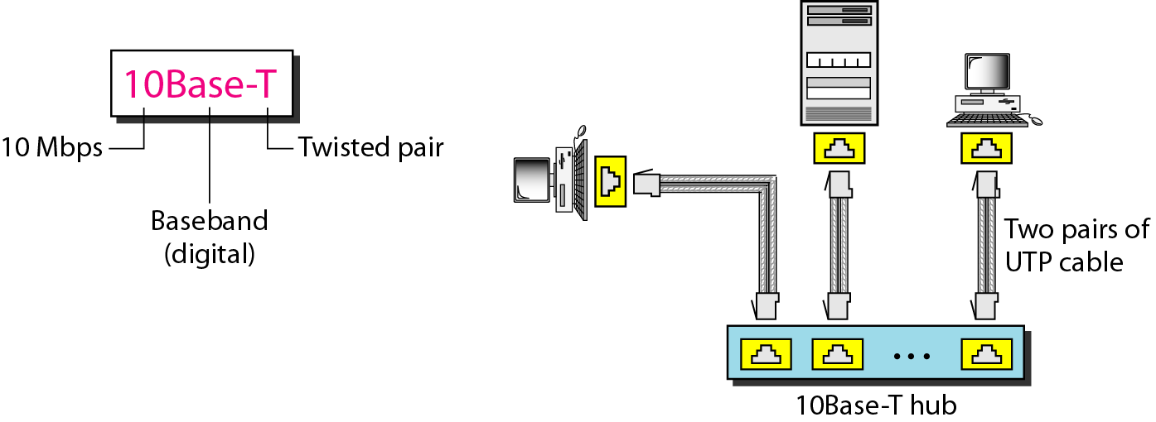
10Base-T implementation

Slide 78
Twisted-pair Ethernet.
The stations are connected to a hub via two
pairs of twisted cable.
Two pairs of twisted cable create two paths
(one for sending and one for receiving)
between the station and the hub.
Replaces the coaxial cable as far as a
collision is concerned.
maximum length = 100m.

Slide 79
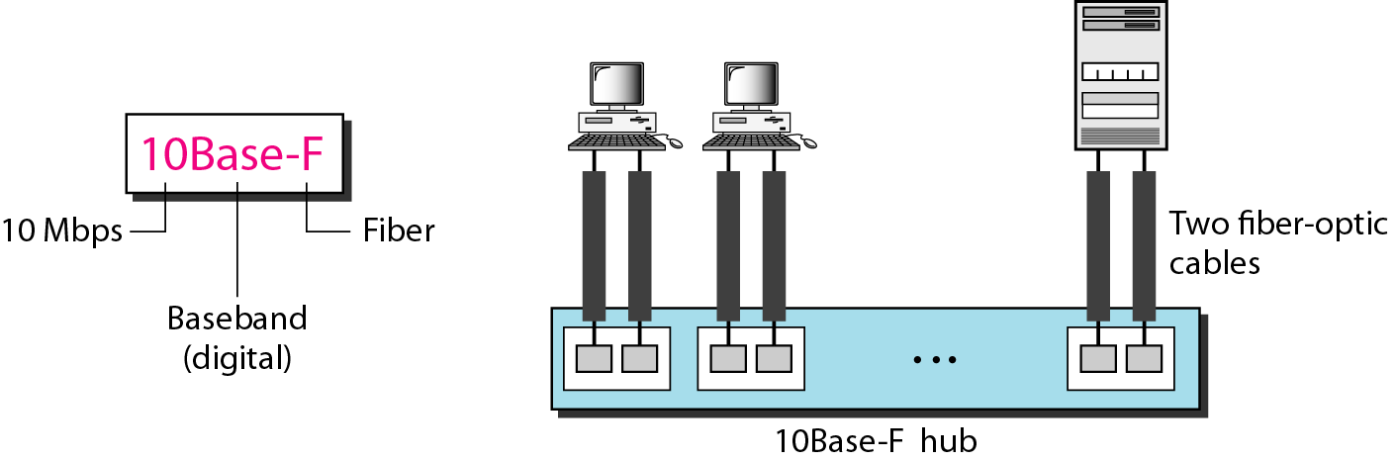
10Base-F implementation

Slide 80
Summary of Standard Ethernet implementations

Slide 81
FAST ETHERNET
Fast Ethernet was designed to compete with LAN protocols such as FDDI (Fiber Distributed Data Interface) or Fiber Channel.
It is a set of ANSI and ISO standards for data transmission on fiber optic lines in a local area network (LAN) that can extend in range up to 200 km (124 miles)
IEEE created Fast Ethernet under the name 802.3u.

Slide 82
Fast Ethernet is backward-compatible with Standard Ethernet, but it can transmit data 10 times faster at a rate of 100 Mbps.
Goal:
1.Upgrade the data rate to 100 Mbps.
2. Make it compatible with Standard Ethernet.
3. Keep the same 48-bit address.
4. Keep the same frame format.
5. Keep the same minimum and maximum
frame lengths.

Slide 83
MAC Sublayer :-
The evolution of Ethernet from 10 to 100 Mbps.
A decision was made to drop the bus topologies
and keep only the star topology.
For the star topology, there are two choices,
half duplex and full duplex.
In the half-duplex approach, the stations are connected via a hub;

Slide 84
In the full-duplex approach, the connection is made via a switch with buffers at each port.
The access method is the same (CSMA/CD) for the half-duplex approach;
For full duplex Fast Ethernet, there is no need for CSMA/CD.
However, the implementations keep CSMA/CD for backward compatibility with Standard Ethernet.

Slide 85
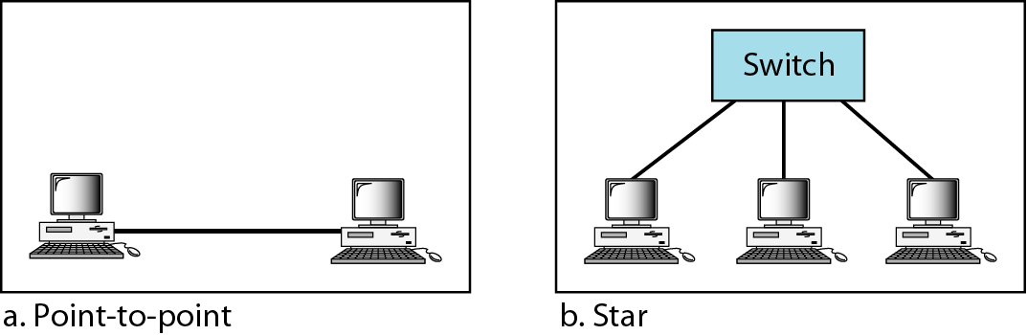
Physical Layer: Fast Ethernet topology

Slide 86
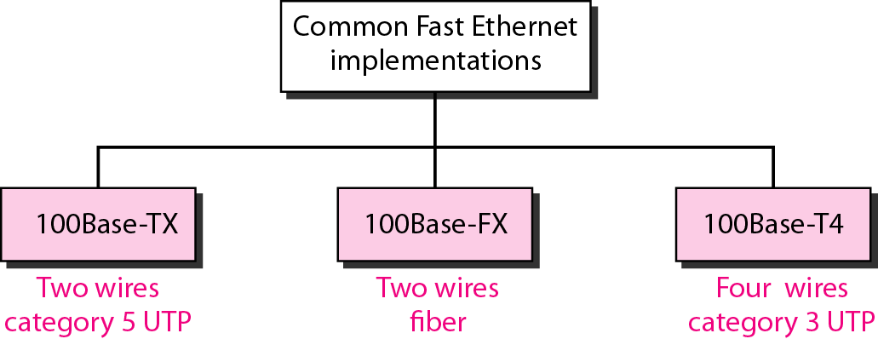
Fast Ethernet implementations

Slide 87
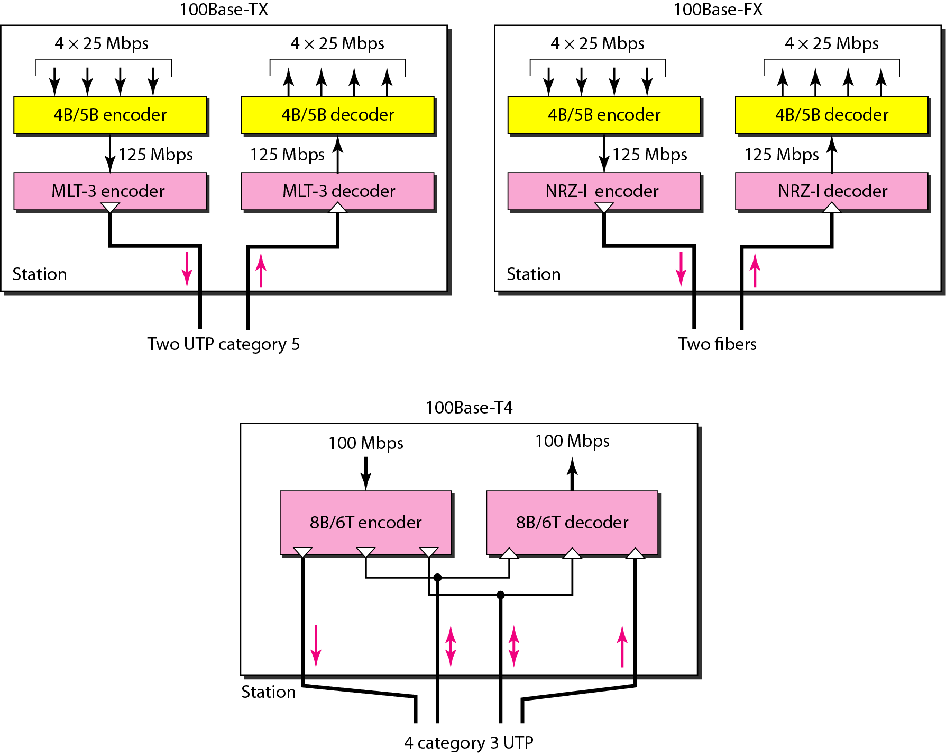
Encoding for Fast Ethernet implementation

Slide 88
1] 1OOBase-TX uses two pairs of twisted-pair cable (either category 5 UTP or STP).
For this implementation, the MLT-3 scheme was selected since it has good bandwidth performance
MLT-3 is not a self-synchronous line coding
scheme, 4B/5B block coding is used to provide bit synchronization by preventing the occurrence of a long sequence of Os and 1s.
This creates a data rate of 125 Mbps, which is fed into MLT-3 for encoding

Slide 89
2] 1OOBase-FX uses two pairs of fiber-optic cables. Optical fiber can easily handle high
bandwidth requirements by using simple encoding schemes.
The designers of 100Base-FX selected the NRZ-I encoding scheme. NRZ-I has a bit synchronization problem for long sequences of Os and 1s .
To overcome this problem, the designers used 4B/5B block coding.
The block encoding increases the bit rate from 100 to 125 Mbps, which can easily be handled by fiber-optic cable.

Slide 90
3] A 1OOBase-TX network can provide a data rate of 100 Mbps, but it requires the use of
category 5 UTP or STP cable.
A new standard, called 1OOBase-T4, was
designed to use category 3 or higher UTP.
It uses four pairs of UTP for transmitting 100 Mbps.
Encoding/decoding in 100Base-T4 is more complicated.

Slide 91
It uses category 3 UTP, each twisted-pair cannot easily handle more than 25 Mbaud.
In this design, one pair switches between sending and receiving. Three pairs of UTP category 3, however, can handle only 75 Mbaud (25 Mbaud) each.
We need to use an encoding scheme that converts 100 Mbps to a 75 Mbaud signal. So we use 8B/6T satisfies this requirement.
In 8B/6T, eight data elements are encoded as six signal elements.

Slide 92
Summary of Fast Ethernet implementations

Slide 93
GIGABIT ETHERNET
The need for an even higher data rate resulted in the design of the Gigabit Ethernet protocol (1000 Mbps). The IEEE committee calls the standard 802.3z.

Slide 94
Goal:
1. Upgrade the data rate to 1 Gbps.
2. Make it compatible with Standard or Fast Ethernet.
3. Use the same 48-bit address.
4. Use the same frame format.
5. Keep the same minimum and maximum frame
lengths.

Slide 95
MAC Sublayer
Gigabit Ethernet has two distinctive approaches for medium access: half-duplex and full-duplex.
Almost all implementations of Gigabit Ethernet follow the full-duplex approach.
In the full-duplex mode of Gigabit Ethernet, there is no collision; the maximum length of the cable is determined by the signal attenuation in the cable.

Slide 96
Half-Duplex Mode
Gigabit Ethernet can also be used in half-duplex mode, although it is rare.
A switch can be replaced by a hub, which acts as the common cable in which a collision might occur.
The half-duplex approach uses CSMAlCD.

Slide 97
Physical Layer
The physical layer in Gigabit Ethernet is more complicated than that in Standard or Fast
Ethernet.

Slide 98
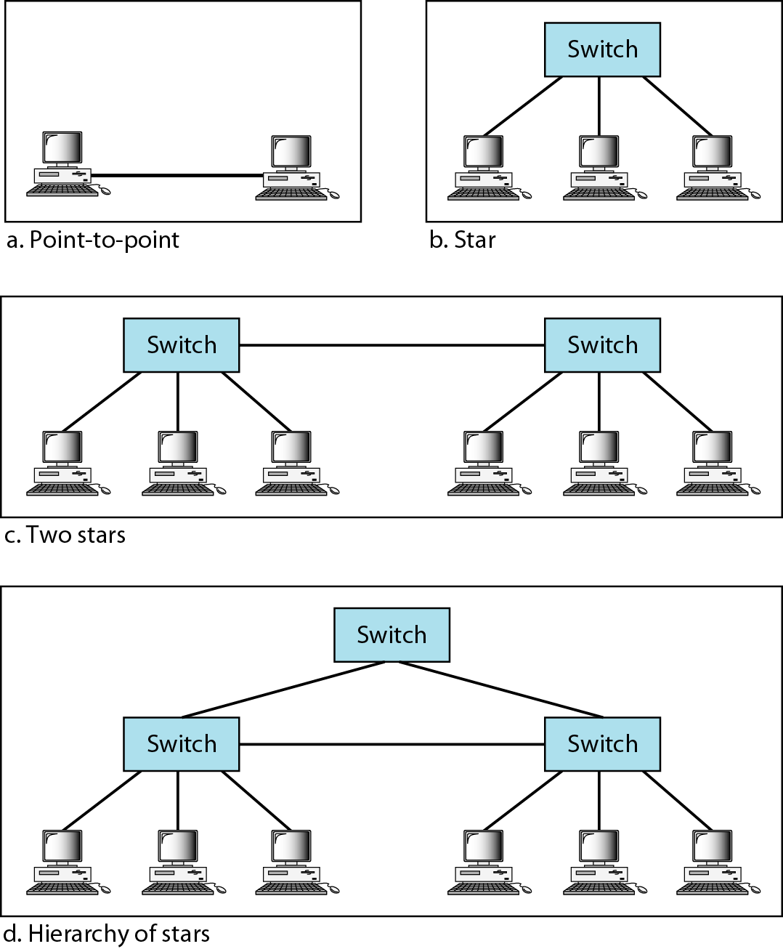
Topologies of Gigabit Ethernet

Slide 99
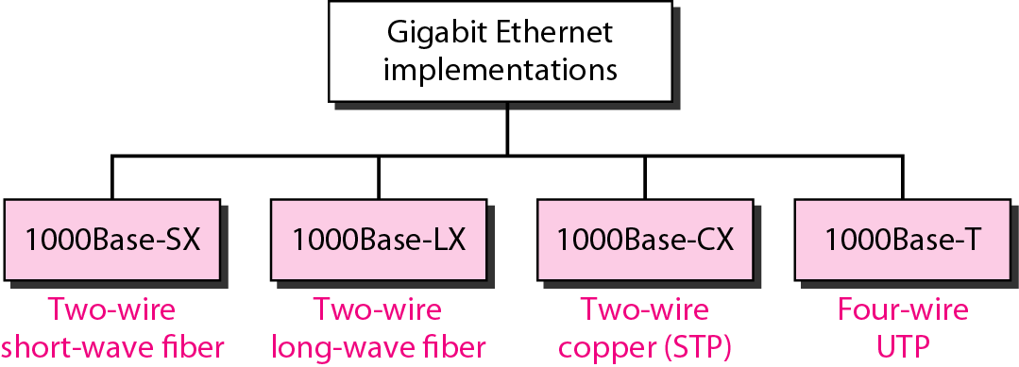
Gigabit Ethernet implementations
Cat-5 Twisted pair cable

Slide 100
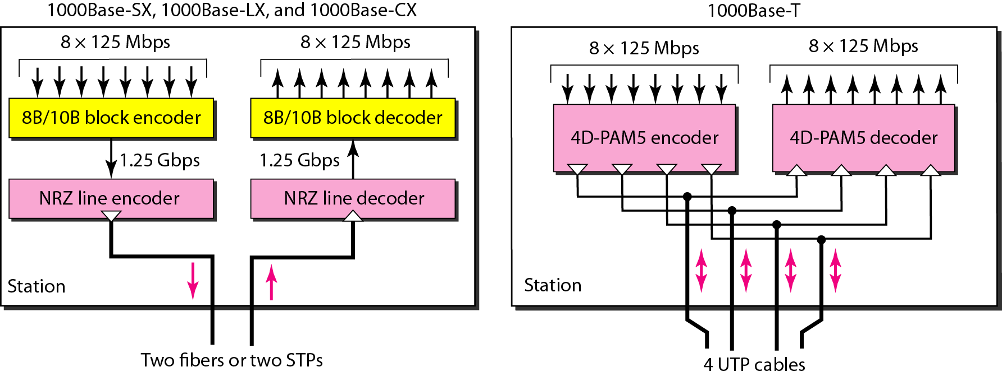
Encoding in Gigabit Ethernet implementations

Slide 101
The two-wire implementations use an NRZ scheme, but NRZ does not self-synchronize properly.
To synchronize bits, particularly at this high
data rate, 8B/10B block encoding, is used.
This block encoding prevents long sequences of 0s or 1s in the stream, but the resulting
stream is 1.25 Gbps.
In this implementation, one wire (fiber or STP) is used for sending and one for receiving.

Slide 102
In the four-wire implementation it is not possible to have 2 wires for input and 2 for
output, because each wire would need to carry 500 Mbps, which exceeds the capacity
for category 5 UTP.
As a solution, 4D-PAM5 encoding is used
to reduce the bandwidth. Thus, all four wires are involved in both input and output; each
wire carries 250 Mbps, which is in the range for category 5 UTP cable.

Slide 103
Summary of Gigabit Ethernet implementations

Slide 104
IEEE 802.11 wireless LANs
Wireless communication is one of the fastest-growing technologies. The demand for connecting devices without the use of cables is increasing everywhere.
Wireless LANs can be found on college campuses, in office buildings, and in many public areas.
we concentrate on two promising wireless technologies for LANs: IEEE 802.11 wireless LANs, sometimes called wireless Ethernet,
and Bluetooth, a technology for small wireless LANs.

Slide 105
IEEE 802.11 wireless LANs :
IEEE has defined the specifications for a wireless LAN, called IEEE 802.11, which covers the physical and data link layers.

Slide 106
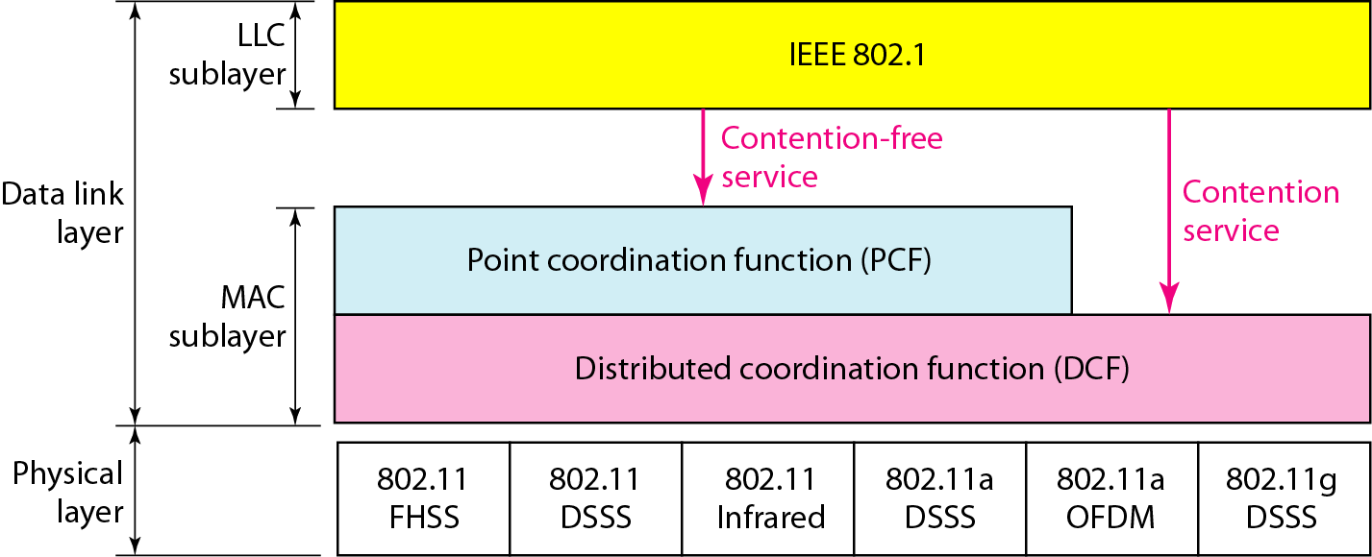
MAC Sublayer
MAC layers in IEEE 802.11 standard

Slide 107
The logical link control(LLC) sublayer provides multiplexing mechanisms that make it possible for several network protocols.
It can also provide flow control and automatic repeat request(ARQ) error management mechanisms.
The LLC sublayer acts as an interface between the media access control (MAC) sublayer and the network layer.

Slide 108
I] Distributed Coordination Function:-(DCF)
One of the two protocols defined by IEEE at the MAC sublayer is called the distributed
coordination function (DCF).
DCF uses CSMA/CA as the access method. Wireless LANs cannot implement CSMA/CD

Slide 109
II] Point Coordination Function (PCF): -
The point coordination function (PCF) is an optional access method that can be implemented
in an infrastructure network (not in an ad hoc network).
It is implemented on top of the DCF and is used mostly for time-sensitive transmission.
PCF has a centralized, contention-free polling access method.
The AP performs polling for stations that are capable of being polled. The stations are polled one after another, sending any data they have to the AP.

Slide 110
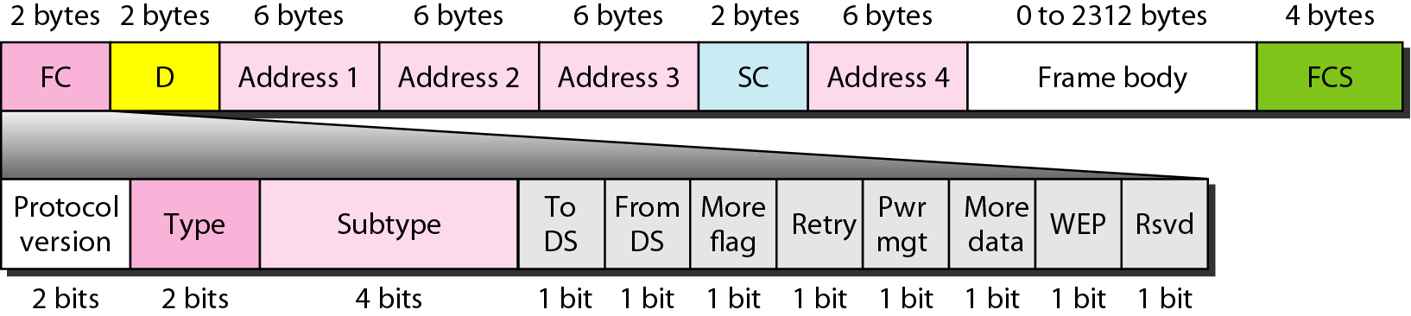
Frame format in MAC layer

Slide 111
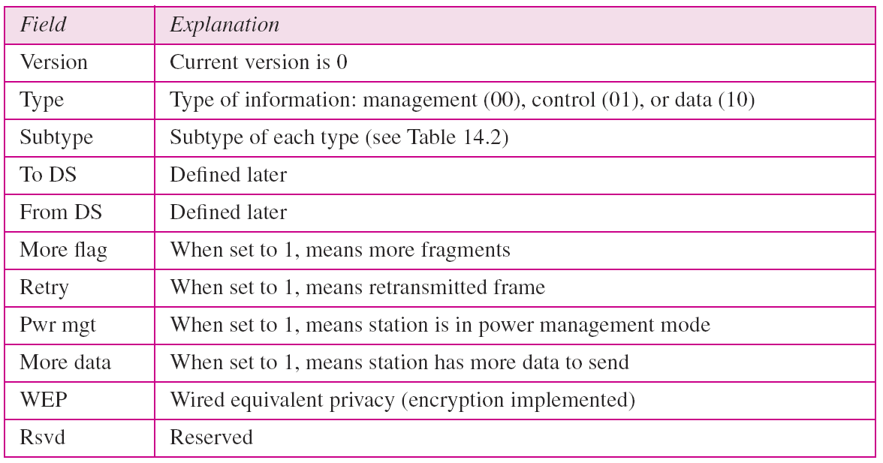
Subfields in FC field

Slide 112
D: - In all frame types except one, this field defines the duration of the transmission
that is used to set the value of NAV (Network Allocation Vector).
Sequence control: - This field defines the sequence number of the frame to be used
in flow control.

Slide 113
Frame body: -
This field, which can be between 0 and 2312 bytes, contains information based on the type and the subtype defined in the FC field.
FCS: -
The FCS field is 4 bytes long and contains a CRC-32 error detection sequence.

Slide 114
Frame Types: -
A wireless LAN defined by IEEE 802.11 has three categories of frames:
1] Management frames,
2] Control frames, and
3] Data frames.

Slide 115
1] Management frames:
Management frames are used for the initial communication between stations and access points.
2] Control Frames: -
Control frames are used for accessing the channel and acknowledging frames.

Slide 116
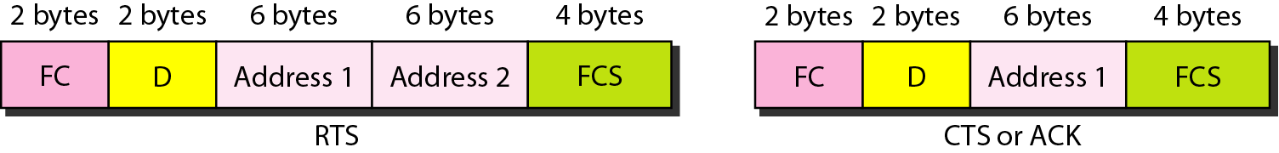
Control frames

Slide 117
3] Data Frames: -
Data frames are used for carrying data and control information.

Slide 118
Comparisons between Ethernet LANs and
Wireless Network
Ethernet | Wireless Network
1.IEEE standard 802.3 | 1.IEEE standard 802.11
2. Communication Medium is coaxial cable. | 2.Infrared or radio frequencies act as medium.
3.Use MAC | 3. Use two MAC Sublayer
4.Uses CDMA/CD | 4.Uses CDMA/CA
5.Efficiency is high | 5.Efficiency is low
6. Large range | 6. Short range

Slide 119
WLAN Standards
Feature | 802.11a | 802.11b | 802.11g
Year ratified | 1999 | 1999 | 2003
Maximum speed using DSSS | — | 11 Mbps | 11 Mbps
Maximum speed using OFDM | 54 Mbps | — | 54 Mbps
Frequency band | 5 GHz | 2.4 GHz | 2.4 GHz
Channels (no overlapped)* | 23 (12) | 11 (3) | 11 (3)
Speeds required by standard (Mbps) | 6, 12, 24 | 1, 2, 5.5, 11 | 6, 12, 24

Slide 120
Differences between IEEE 802.11?
 | IEEE 802.11 | IEEE 802.11b | IEEE 802.11a | IEEE 802.11g
Frequency | 2.4G Hz | 2.4G Hz | 5 G Hz | 2.4G Hz
Transmission Rate | 1~2 Mbps | 1~11Mbps | 6~54 Mbps | 22~54Mbps
Modulation Technique | FHSS/DSSS | FHSS/DSSS | OFDM | PBCC-22 + CCK-OFDM

Slide 121
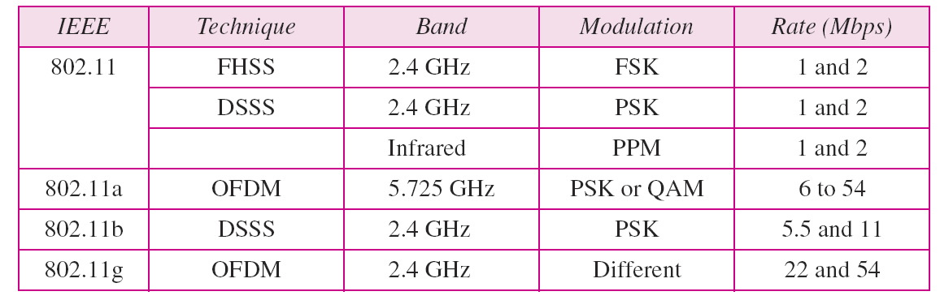
Physical layers
Where FHSS:-Frequency hopping spread spectrum
DSSS:-Direct sequence spread spectrum
OFDM: - Orthogonal Frequency-Division Multiplexing.

Slide 122
The 802.11a , 802.11b/g/n , and/or 802.11 ac wireless standards collectively known as
Wi-Fi technologies. ( Bluetooth and various other wireless).

Slide 123
1] 802.11: -
In 1997, the Institute of Electrical and Electronics Engineers (IEEE) created the first WLAN standard . They called it 802.11 after the name of the group formed to oversee its development.
Unfortunately, 802.11 only supported a maximum network bandwidth of 2Mbps - too slow for most applications.
For this reason, ordinary 802.11 wireless products are no longer manufactured.

Slide 124
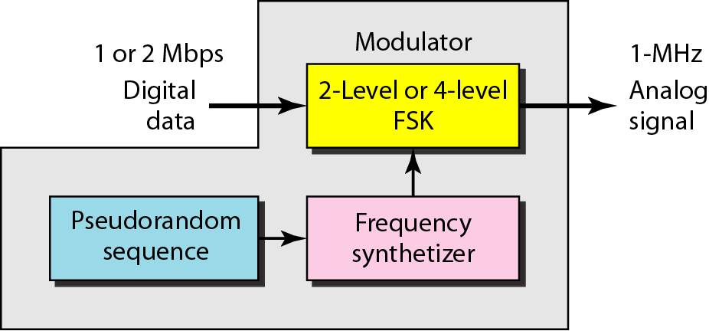
Physical layer of IEEE 802.11 FHSS
FSK: -Frequency shift keying

Slide 125
SPREAD SPECTRUM:-
Multiplexing combines signals from several sources to achieve bandwidth efficiency; the available bandwidth of a link is divided between the sources.
In spread spectrum (SS), we also combine signals from different sources to fit into a larger bandwidth, but our goals are somewhat different.
To achieve these goals, spread spectrum techniques add redundancy.

Slide 126
They spread the original spectrum needed for each station.
If the required bandwidth for each station is B, spread spectrum expands it to Bss' such that Bss » B.
The expanded bandwidth allows the source to wrap its message in a protective envelope for a more secure transmission.

Slide 127
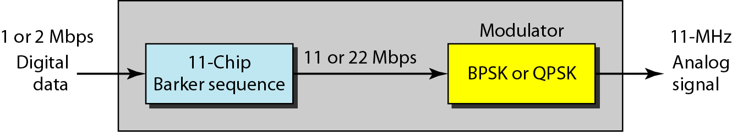
Physical layer of IEEE 802.11 DSSS
BPSK: -Binary phase shift keying.
QPSK: -Quadrature Phase Shift Keying.

Slide 128
The direct sequence spread spectrum (DSSS) technique also expands the bandwidth
of the original signal, but the process is different.
In DSSS, we replace each data bit with n bits using a spreading code.
In other words, each bit is assigned a code of n bits, called chips, where the chip rate is n times that of the data bit.

Slide 129
2] 802.11b:-
IEEE expanded on the original 802.11 standard in July 1999, creating the 802.11b specification.
802.11b supports bandwidth up to 11 Mbps, comparable to traditional Ethernet.
802.11b uses the same unregulated radio signaling frequency (2.4 GHz) as the original 802.11 standard.

Slide 130
Vendors often prefer using these frequencies to lower their production costs.
Pros of 802.11b - lowest cost; signal range is good and not easily obstructed.
Cons of 802.11b - slowest maximum speed; home appliances may interfere on the unregulated frequency band.

Slide 131
3] 802.11a
While 802.11b was in development, IEEE created a second extension to the original 802.11 standard called 802.11a .
Because 802.11b gained in popularity much faster than did 802.11a, some folks believe that 802.11a was created after 802.11b.
In fact, 802.11a was created at the same time. Due to its higher cost, 802.11a is usually found on business networks whereas 802.11b better serves the home market.

Slide 132
802.11a supports bandwidth up to 54 Mbps and signals in a regulated frequency spectrum around 5 GHz.
Because 802.11a and 802.11b utilize different frequencies, the two technologies are incompatible with each other.
Pros of 802.11a - fast maximum speed; regulated frequencies prevent signal interference from other devices.
Cons of 802.11a - highest cost; shorter range signal that is more easily obstructed.

Slide 133
4] 802.11g
In 2002 and 2003, WLAN products supporting a newer standard called 802.11g emerged on the market.
802.11g attempts to combine the best of both 802.11a and 802.11b.
802.11g supports bandwidth up to 54 Mbps , and it uses the 2.4 GHz frequency for greater range.

Slide 134
802.11g is backwards compatible with 802.11b, meaning that 802.11g access points will work with 802.11b wireless network adapters and vice versa.
Pros of 802.11g - fast maximum speed; signal range is good and not easily obstructed.
Cons of 802.11g - costs more than 802.11b; appliances may interfere on the unregulated signal frequency.

Slide 135
5] 802.11n: -
802.11n (also sometimes known as " Wireless N ") was designed to improve on 802.11g in the amount of bandwidth supported by utilizing multiple wireless signals and antennas.
Industry standards groups ratified 802.11n in 2009 with specifications providing for up to 300 Mbps of network bandwidth.

Slide 136
802.11n also offers somewhat better range over earlier Wi-Fi standards due to its increased signal intensity, and it is backward-compatible with 802.11b/g gear.
Pros of 802.11n - fastest maximum speed and best signal range; more resistant to signal interference from outside sources.
Cons of 802.11n - standard is not yet finalized; costs more than 802.11g; the use of multiple signals may greatly interfere with nearby 802.11b/g based networks.

Slide 137
BLUETOOTH:- IEEE 802.15 Standard
Bluetooth is a wireless LAN technology designed to connect devices of different functions such as telephones, notebooks, computers, cameras, printers, coffee makers, and so on. A Bluetooth LAN is an ad hoc network, which means that the network is formed spontaneously.

Slide 138
Bluetooth technology is the implementation of a protocol defined by the IEEE 802.15 standard.
The standard defines a wireless personal-area network (PAN) operable in an area the size of a room or a hall.
Architecture :-
Bluetooth defines two types of networks: piconet and scatternet.

Slide 139
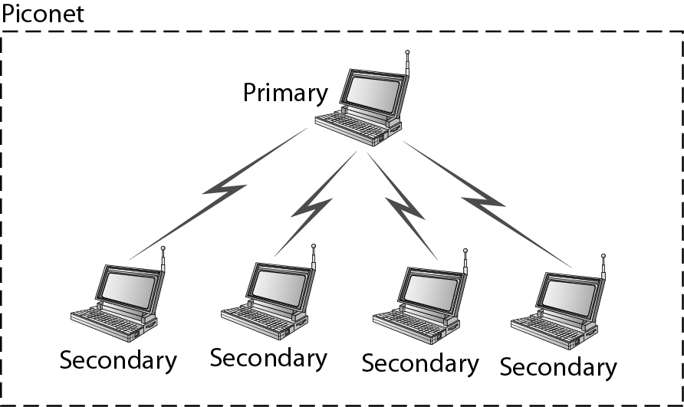
Piconet

Slide 140
Small net.
A piconet can have up to eight stations.
All the secondary stations synchronize their
clocks and hopping sequence with the primary.
The communication between the primary and
the secondary can be one-to-one or one-to-
many.

Slide 141
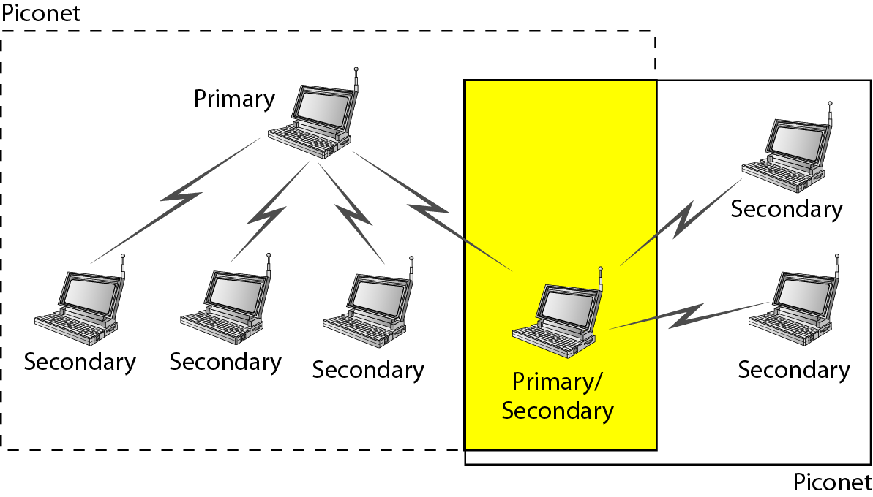
Scatternet

Slide 142
Piconets can be combined to form what is called a scatternet.
A secondary station in one piconet can be the primary in another piconet.
This station can receive messages from the primary in the first piconet (as a secondary) and, acting as a primary, deliver them to secondaries in the second piconet.
A station can be a member of two piconets.

Slide 143
Bluetooth Devices
A Bluetooth device has a built-in short-range radio transmitter. The current data rate is
1 Mbps with a 2.4-GHz bandwidth.
This means that there is a possibility of interference between the IEEE 802.11b wireless LANs and Bluetooth LANs.

Slide 144

Frame format types

Slide 145
Access code. This 72-bit field normally contains synchronization bits and the identifier of the primary to distinguish the frame of one piconet from another.
Header.
subfields:
1. Address. The 3-bit address subfield can define up to seven secondaries (1 to 7).
If the address is zero, it is used for broadcast communication from the primary to all secondaries.

Slide 146
F. This 1-bit subfield is for flow control. When set (1), it indicates that the device is unable to receive more frames (buffer is full).
A. This 1-bit subfield is for acknowledgment. Bluetooth uses Stop-and-Wait ARQ; 1 bit is sufficient for acknowledgment.
S. This 1-bit subfield holds a sequence number. Bluetooth uses Stop-and-Wait ARQ; 1 bit is sufficient for sequence numbering.
HEC. The 8-bit header error correction subfield is a checksum to detect errors in each 18-bit header section.

Slide 147
Payload.
This subfield can be 0 to 2740 bits long. It contains data or control information coming from the upper layers.

Slide 148
Binary Exponential Backoff Algorithm
Binary exponential backoff refers to a collision resolution mechanism used in random access MAC protocols.
This algorithm is used in Ethernet (IEEE 802.3) wired LANs. In Ethernet networks, this algorithm is commonly used to schedule retransmissions after collisions.
‏

Slide 149
Definitions of the components/Keywords:
After a collision, time is divided into discrete slots whose length is equal to 2τ, where τ is the maximum propagation delay in the network.
The reason for this choice is that 2τ is the minimum amount of time a source needs to listen to the channel to always detect a collision.
After 16 collisions , the process is aborted and
the source stops trying.

Slide 150
Flow diagram for the CSMA/CD

Slide 151
The stations involved in the collision randomly pick an integer from the set {0,1}. This set is called the contention window.
If the sources collide again because they picked the same integer, the contention window size is doubled and it becomes {0,1,2,3}. Now the sources involved in the second collision randomly pick an integer from the set {0,1,2,3} and wait that number of slot times before trying again.

Slide 152
IEEE 802.16 Wireless MAN (Wireless Metropolitan Network)

Slide 153
802.16 family of standards is officially called Wireless MAN in IEEE, it has been commercialized under the name "WiMAX" (from "Worldwide Interoperability for Microwave Access") by the WiMAX Forum industry alliance.

Slide 154


Slide 155

802.16 Architecture and Protocol Stack
The 802.16 protocol stack

Slide 156

802.16 Physical Layer
Frames structure for OFDMA with time division duplexing.

Slide 157
802.16 MAC Sublayer Protocol
Classes of service
Constant bit rate service.
Real-time variable bit rate service.
Non-real-time variable bit rate service.
Best-effort service.

Slide 158

802.16 Frame Structure
(a) A generic frame. (b) A bandwidth request frame.

